Slide 1
Biology Lab Observation
Microbiology Lab

Slide 2
Overview
Bacterial and Microbe Growth
Media Types
Techniques

Slide 3
Microbes and Cultures
Must be able to extract individual organisms in order to study / characterize them
Worked with E-coli

Slide 4
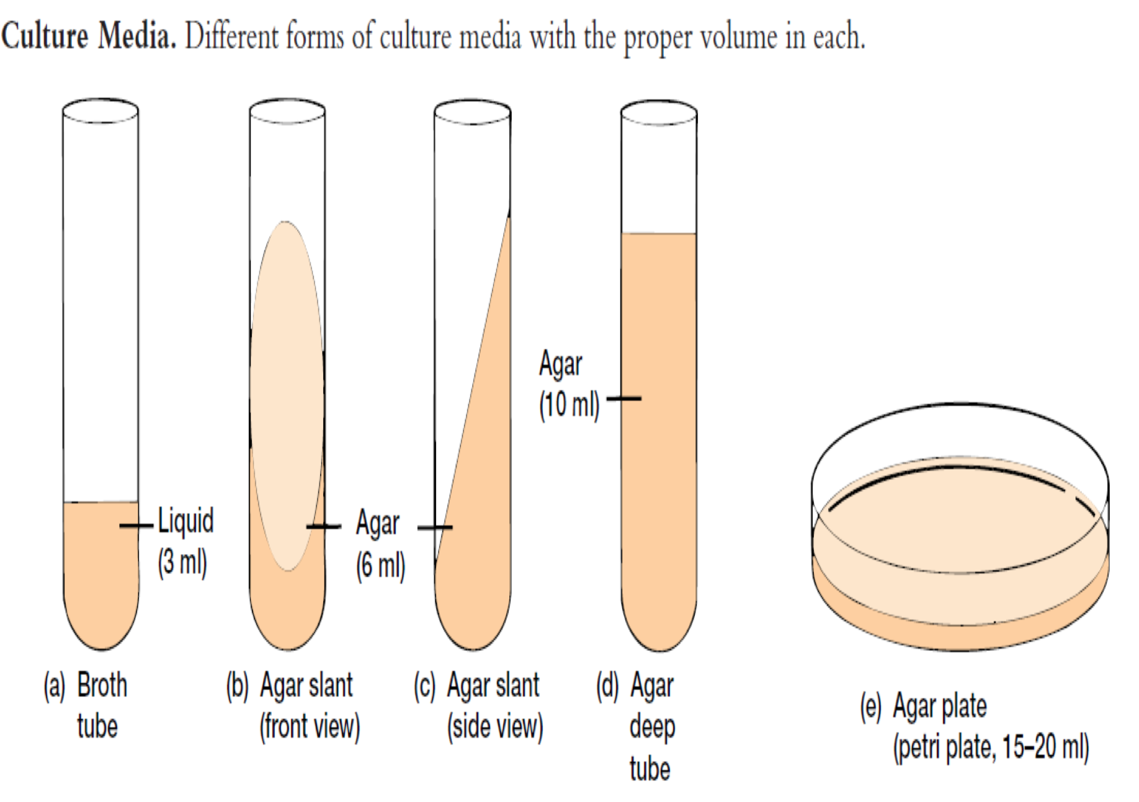
Mediums
Agar is a solid growth medium, plus nutrients

Slide 5
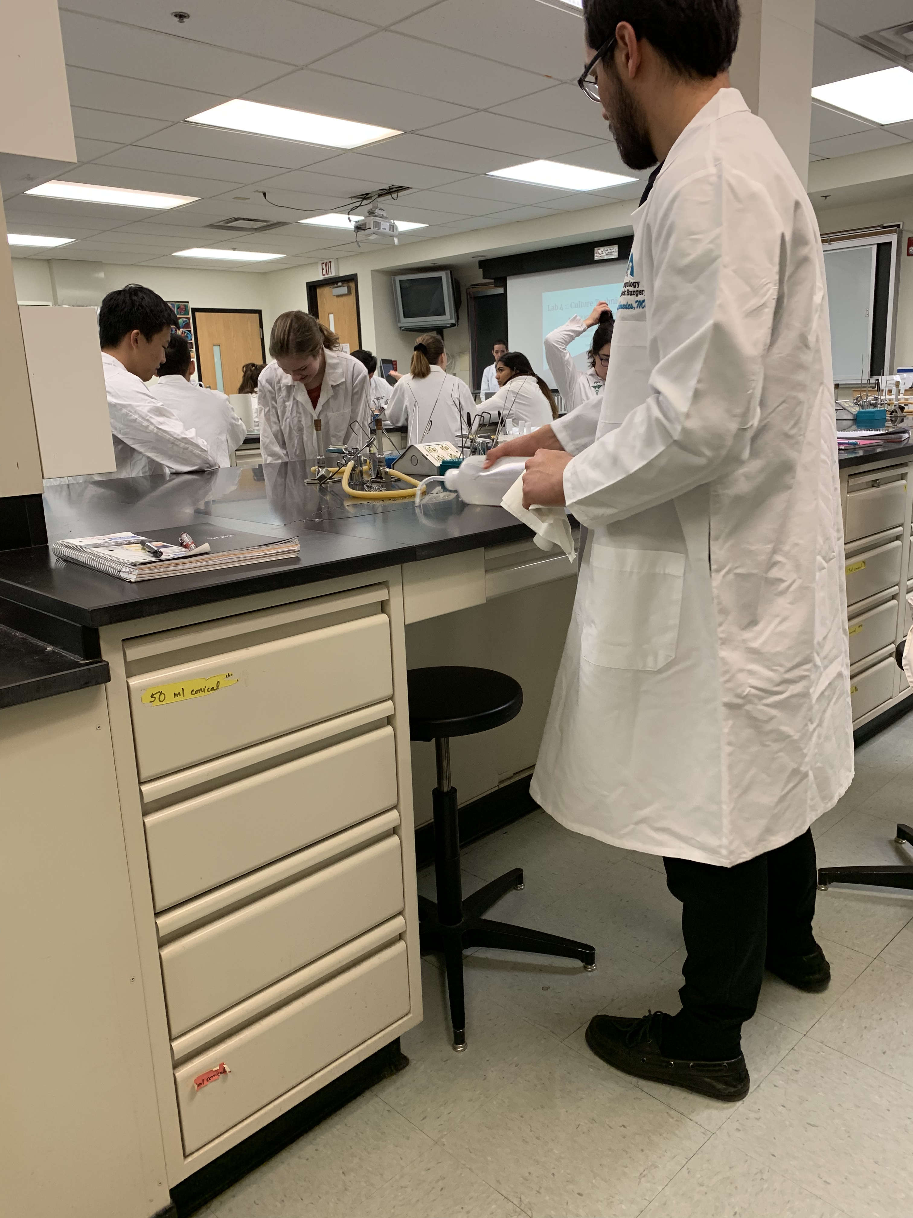

Slide 6
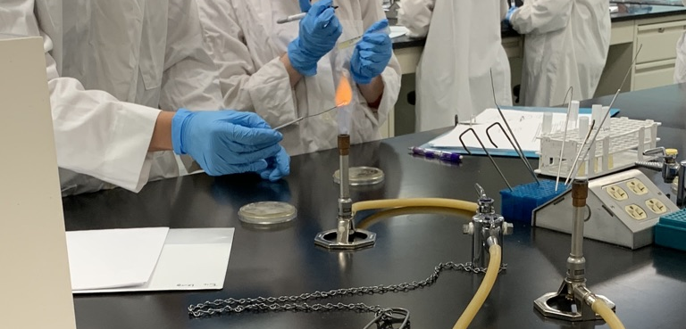
Inoculation needle being sterilized via Bunsen burner

Slide 7
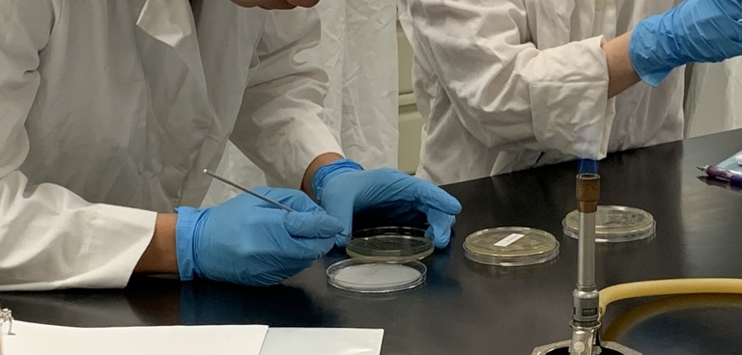
Streak Plating

Slide 9


Slide 10
